Slide 1
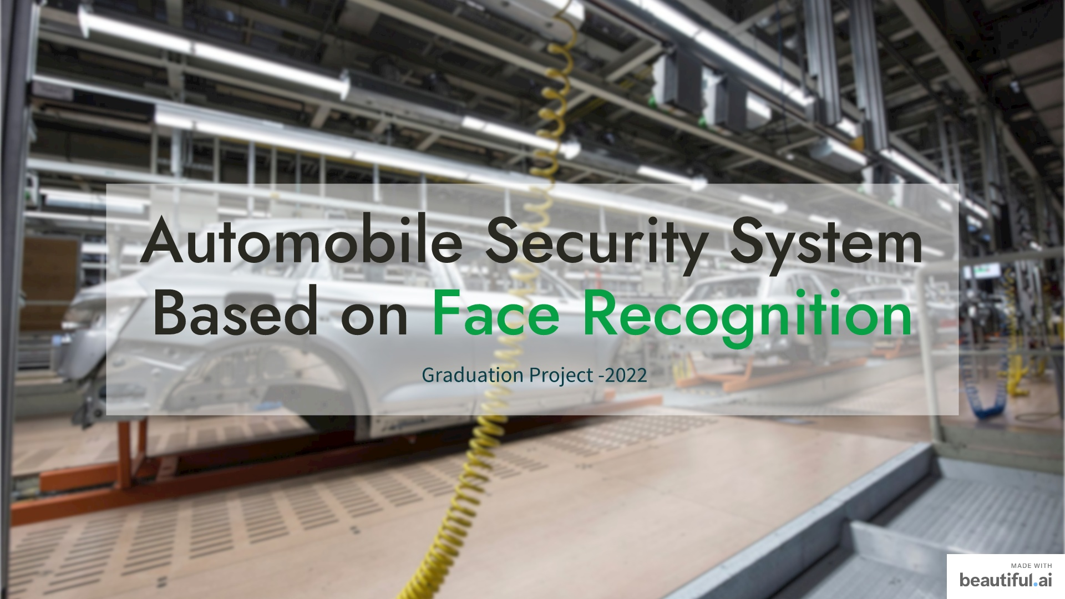

Slide 2
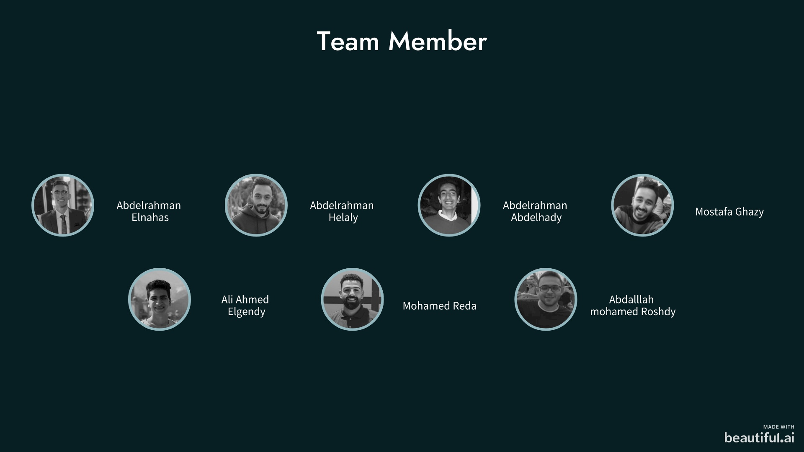
SUPERVISOR
Prof. Sherif Kishk

Slide 3
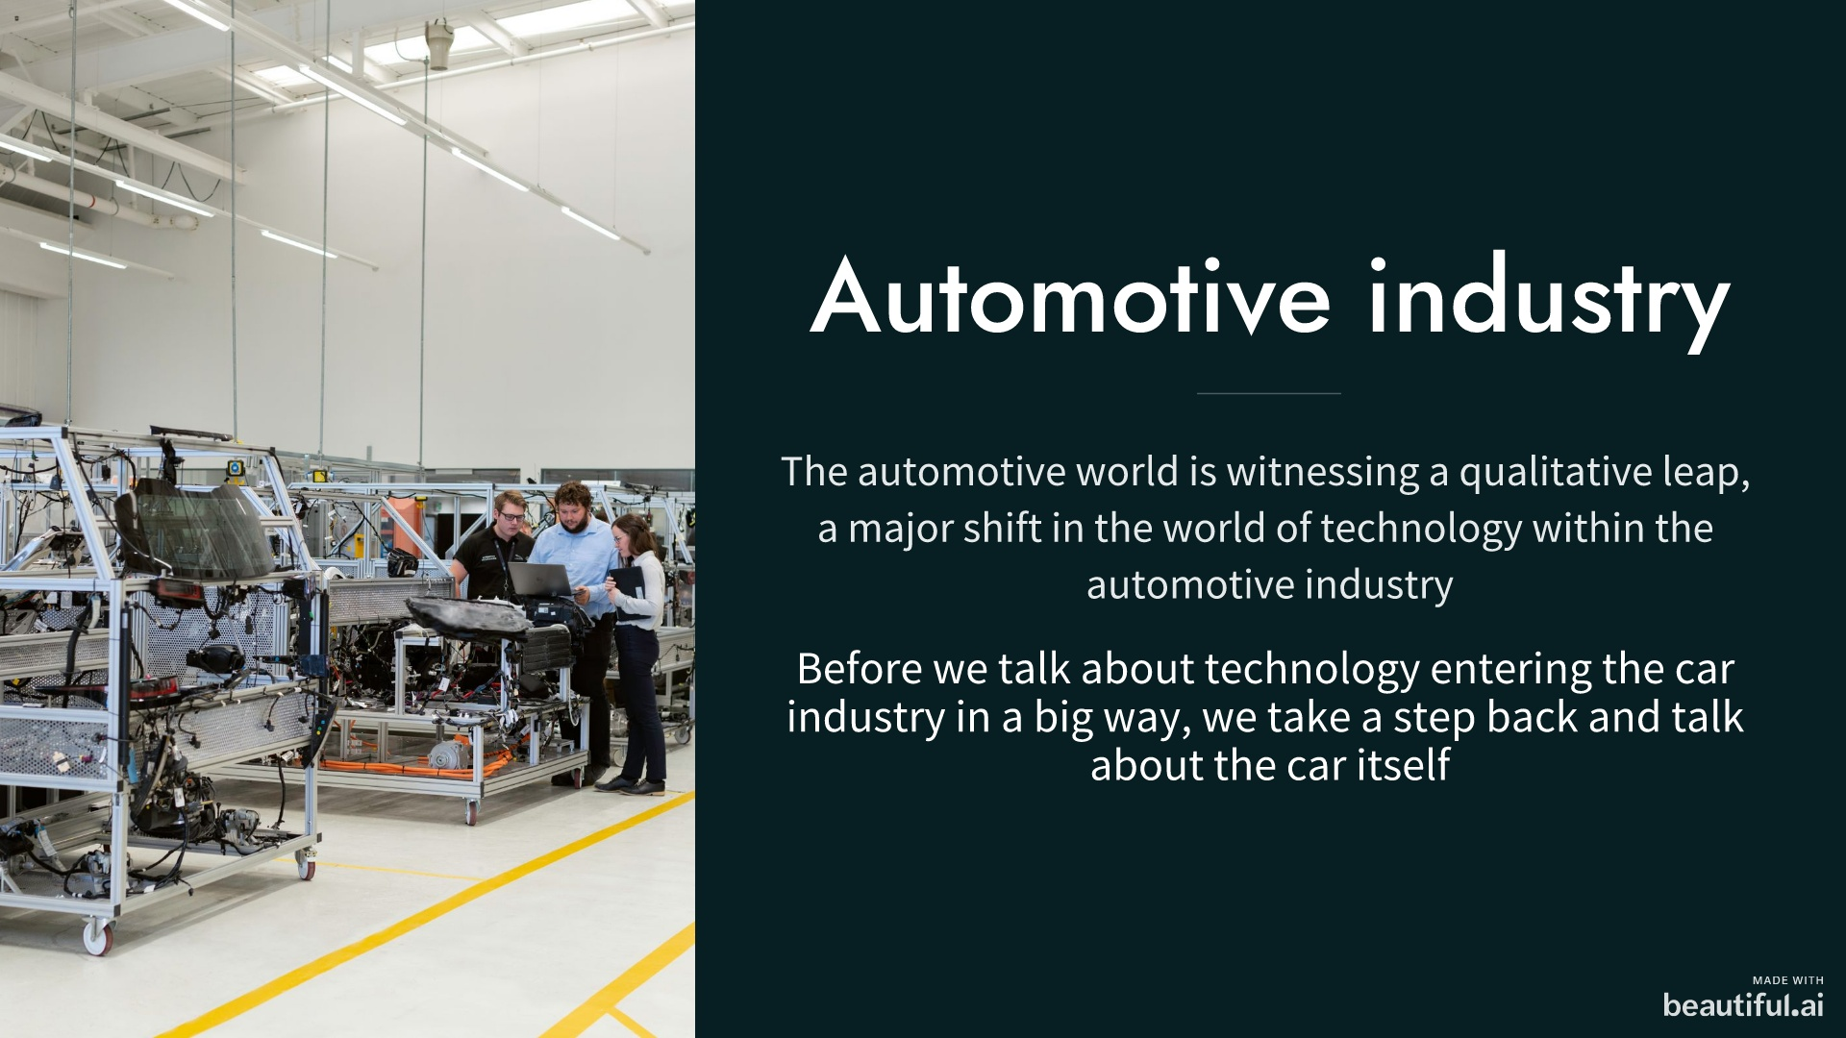

Slide 4
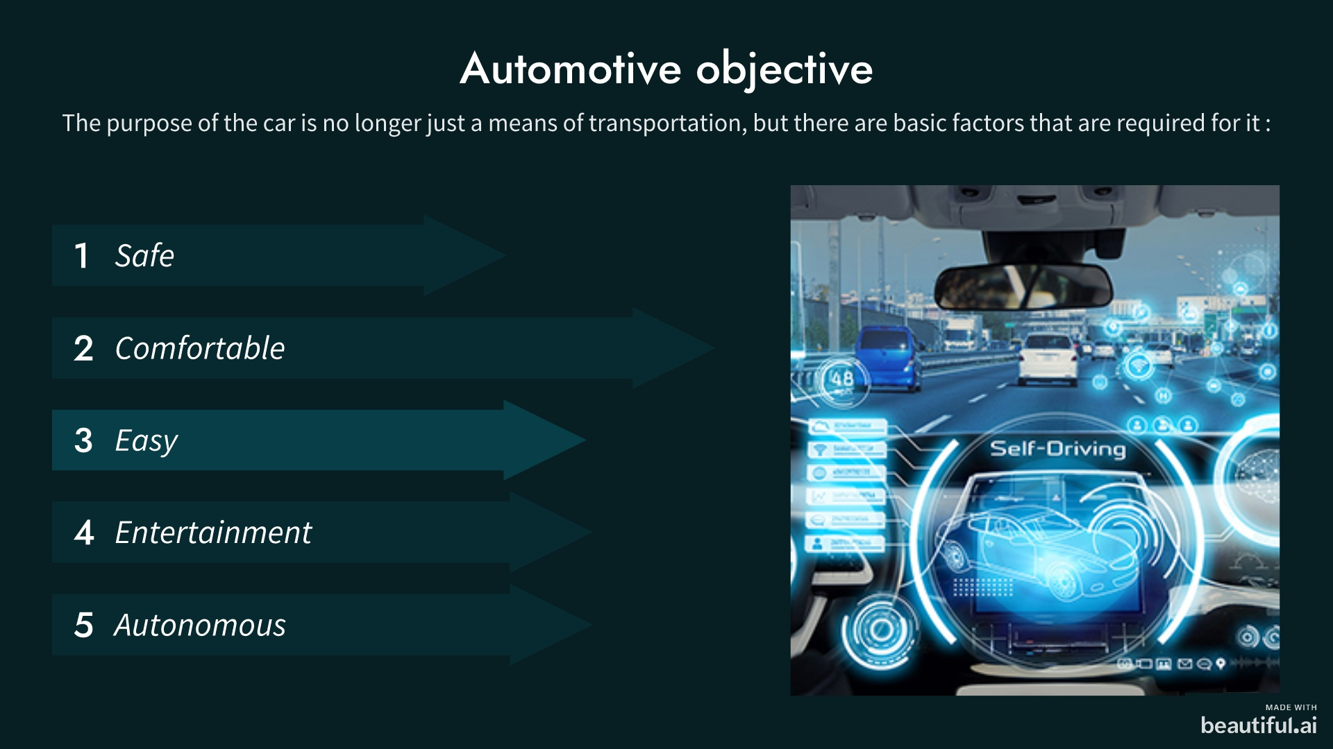

Slide 5
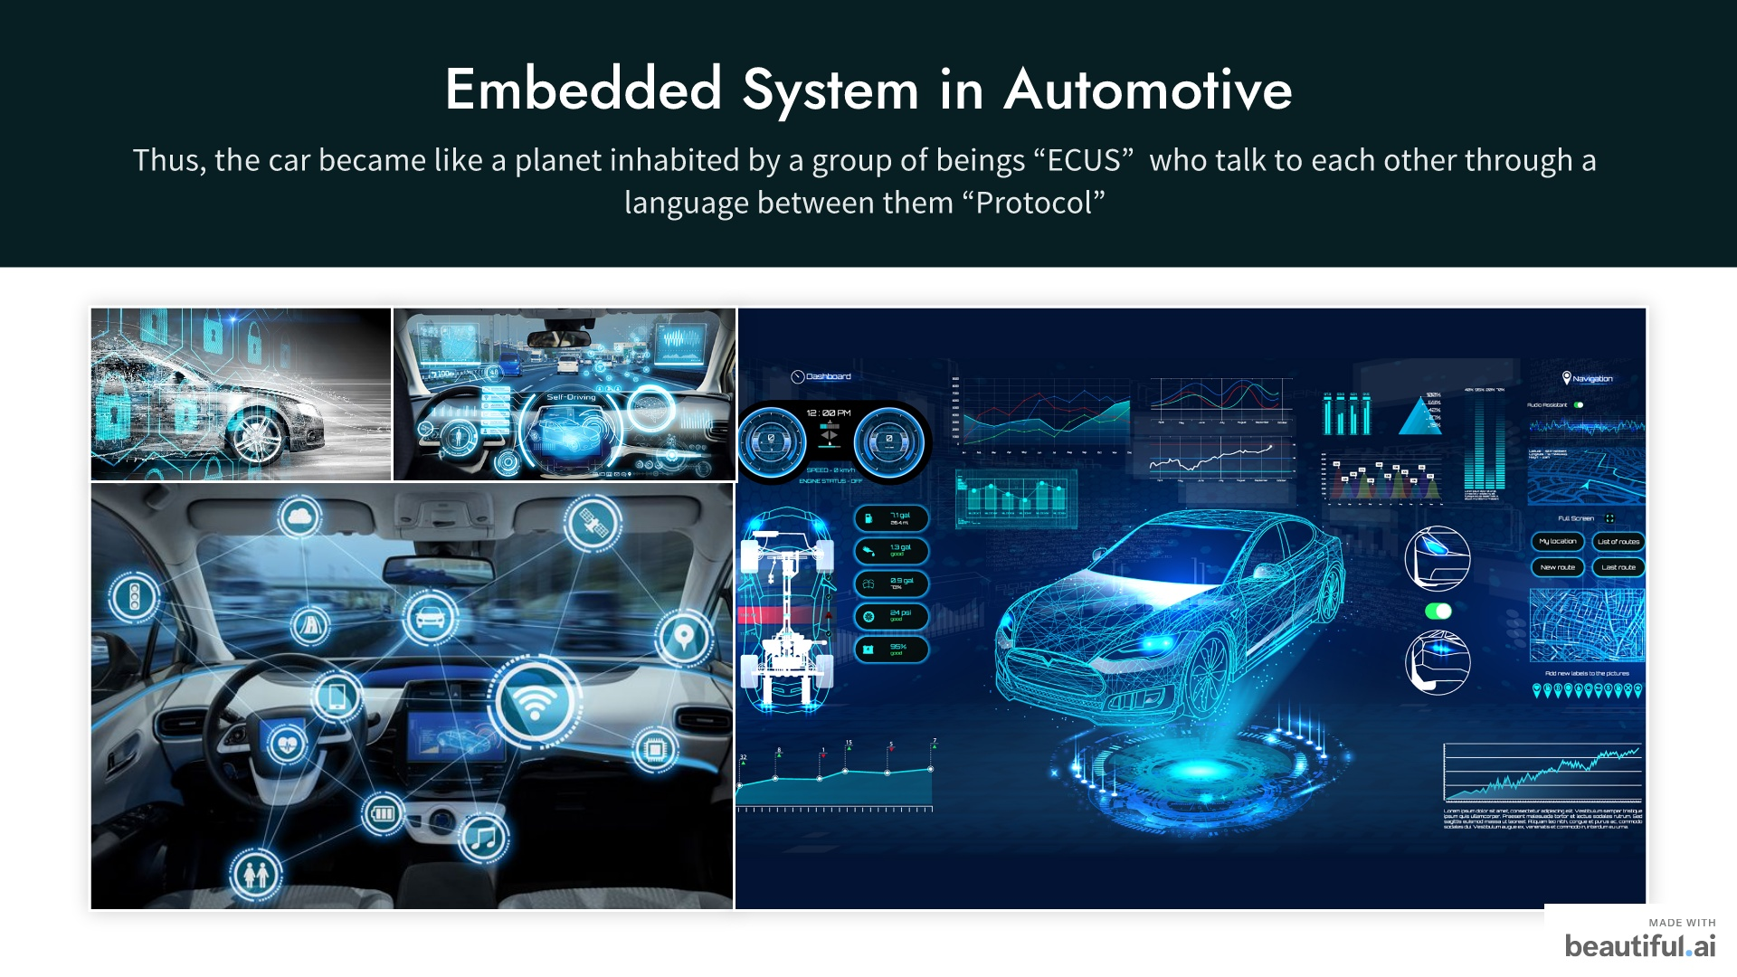

Slide 6
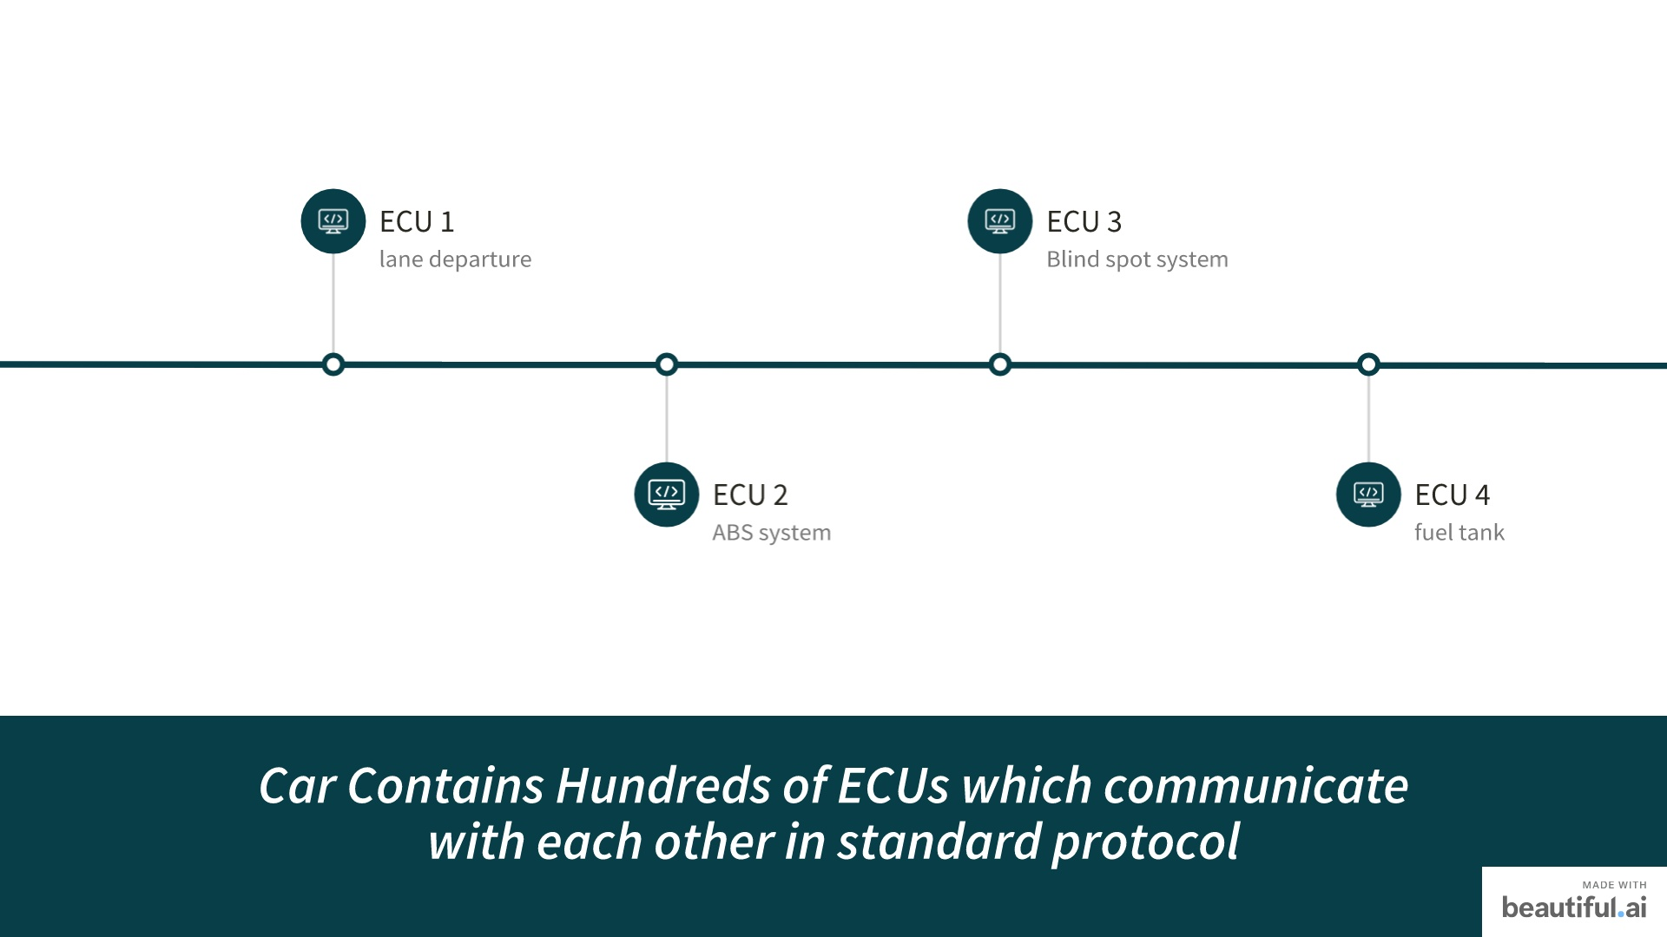

Slide 7
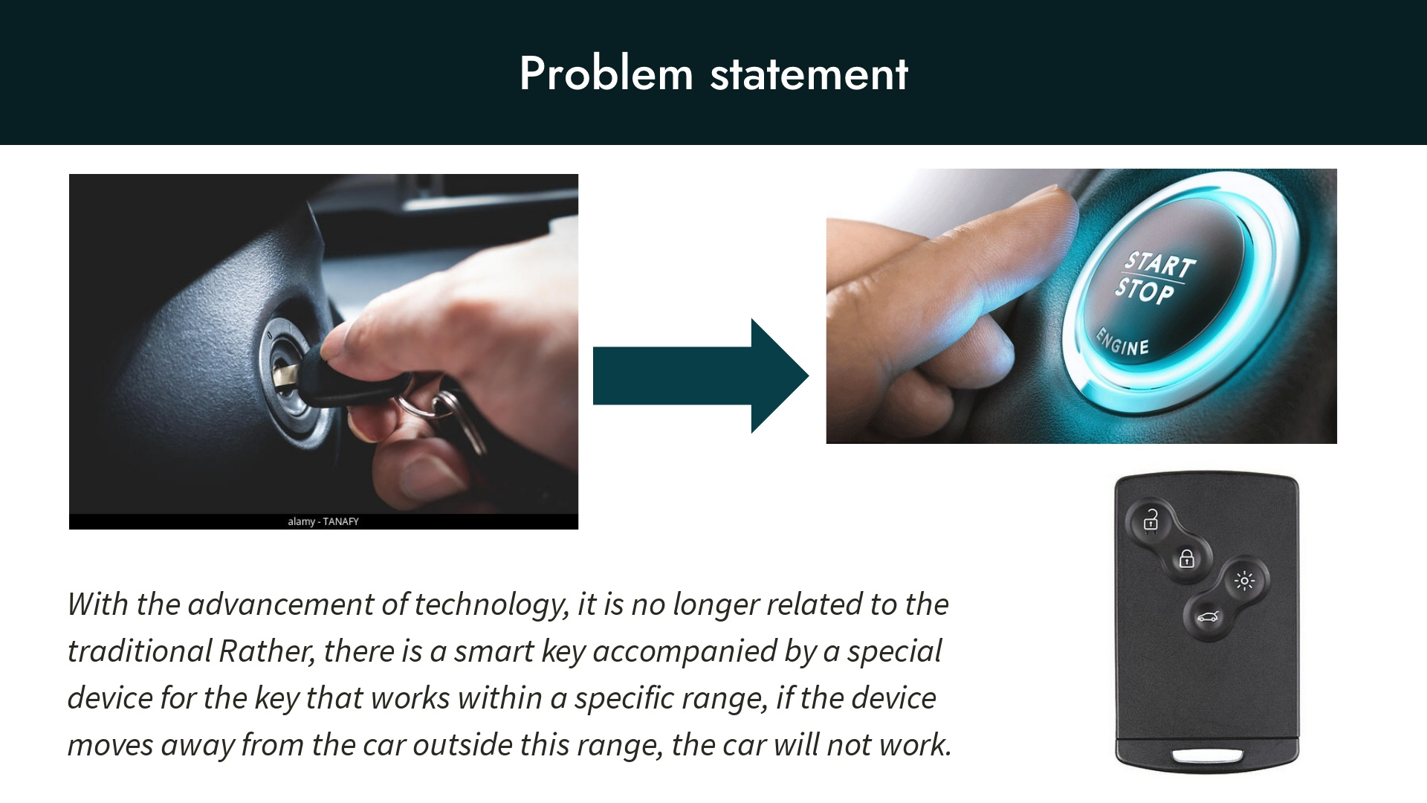

Slide 8
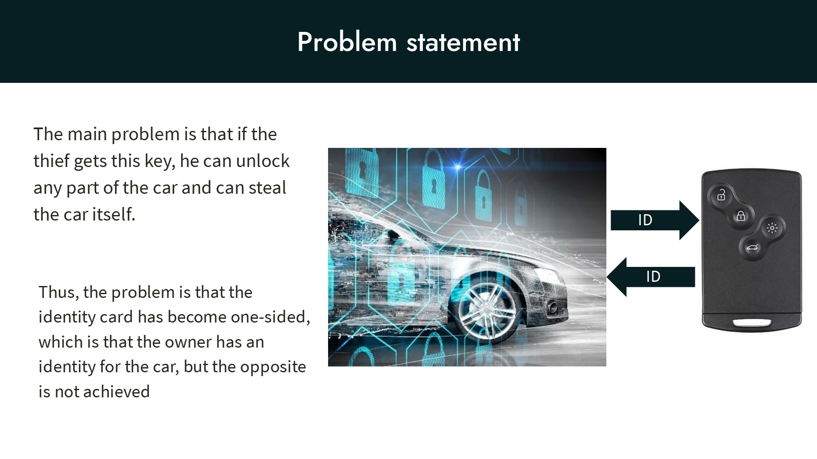

Slide 9
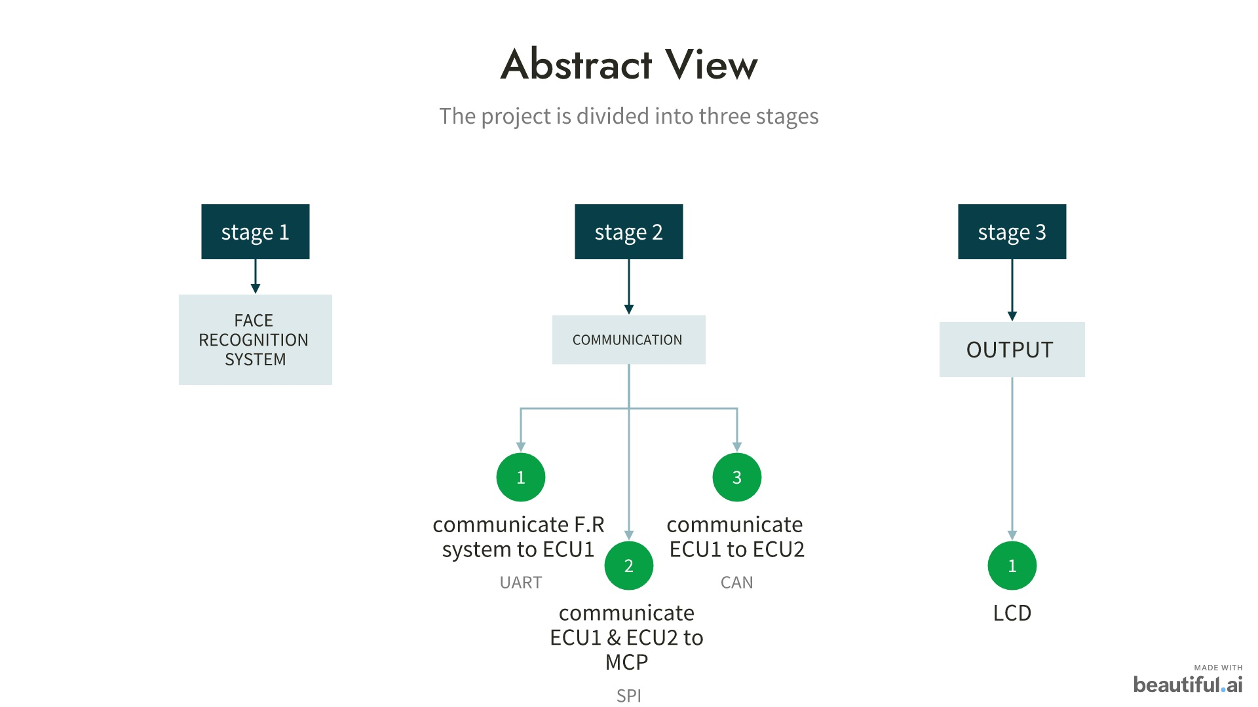

Slide 10
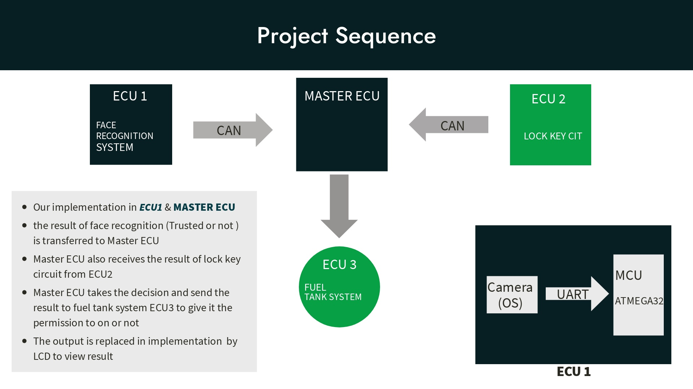

Slide 11
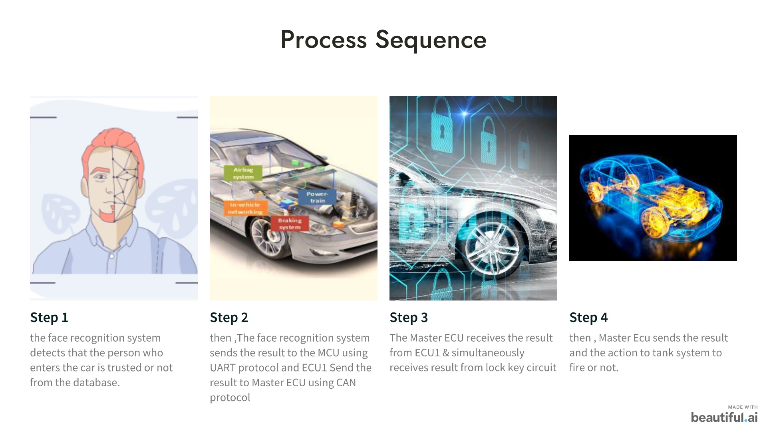

Slide 12

Face Recognition

Slide 13

Open CV Library
Computer Vision is one of the most interesting and Challenging tasks.
Computer Vision acts like a bridge between Computer Software and visualizations around us.

Slide 14
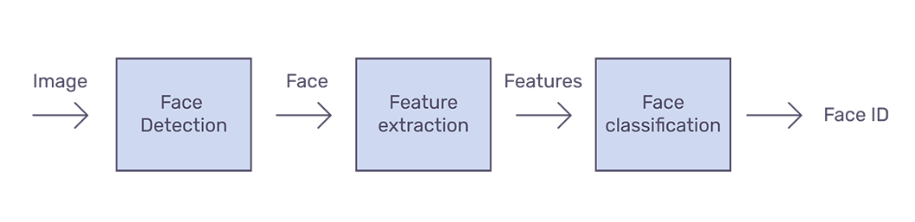
Face Recognition Process

Slide 15

1- Face Detection

Slide 16
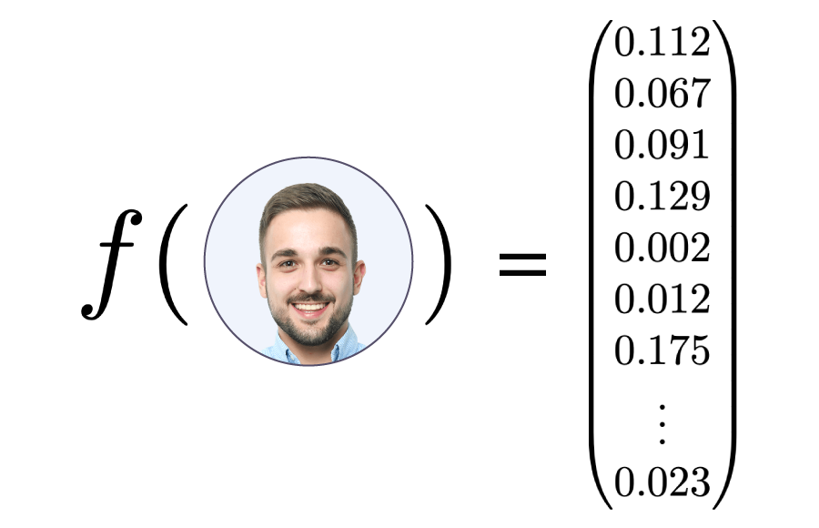

2- Features extraction

Slide 17
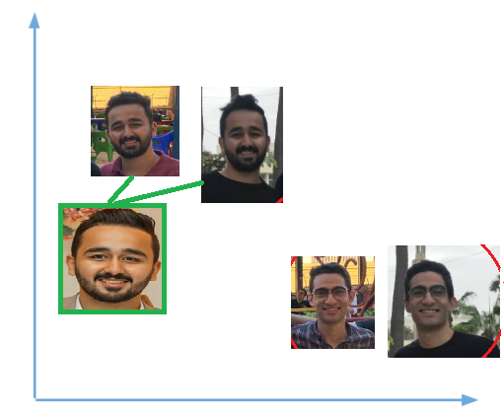
3- Face classification

Slide 18
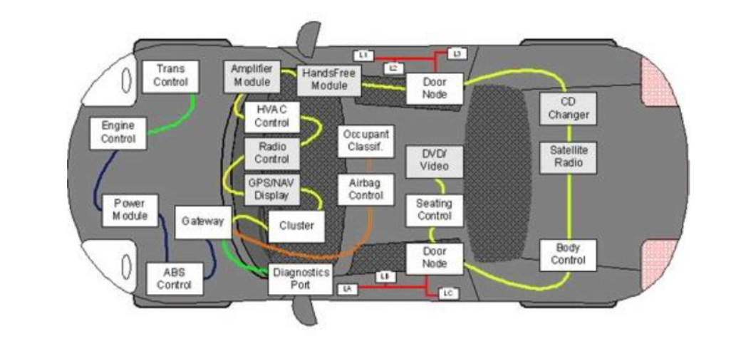
Communication Concepts

Slide 19
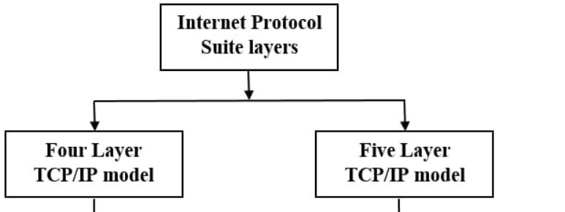



Communications Protocols
Communications Protocols
Standard protocol
Not Standard protocol
CAN
LIN
SPI
UART

Slide 20
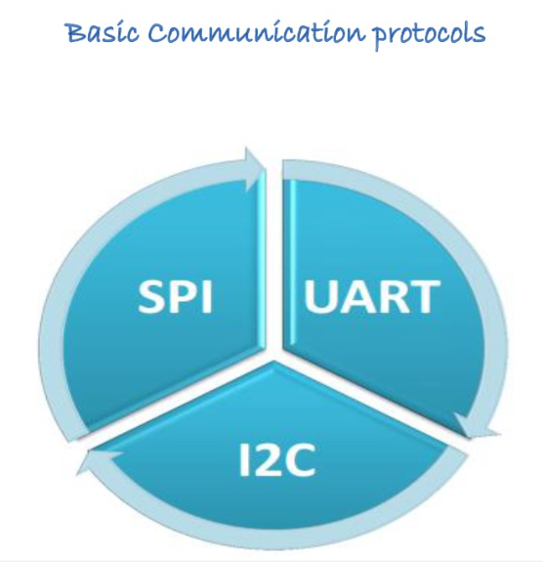

Slide 21
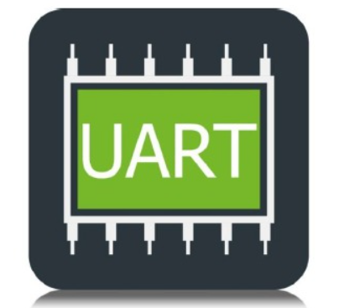
UART Concepts
What is UART ?
1- Specification
2- Hardware connection
3- Data Frame Format

Slide 22
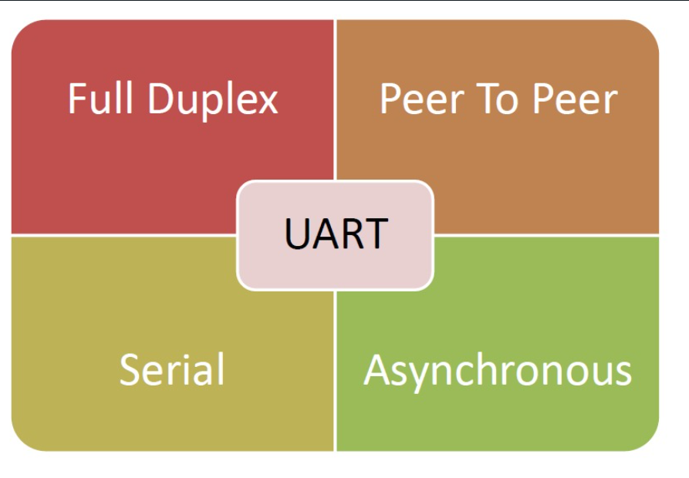
UART specifications

Slide 23
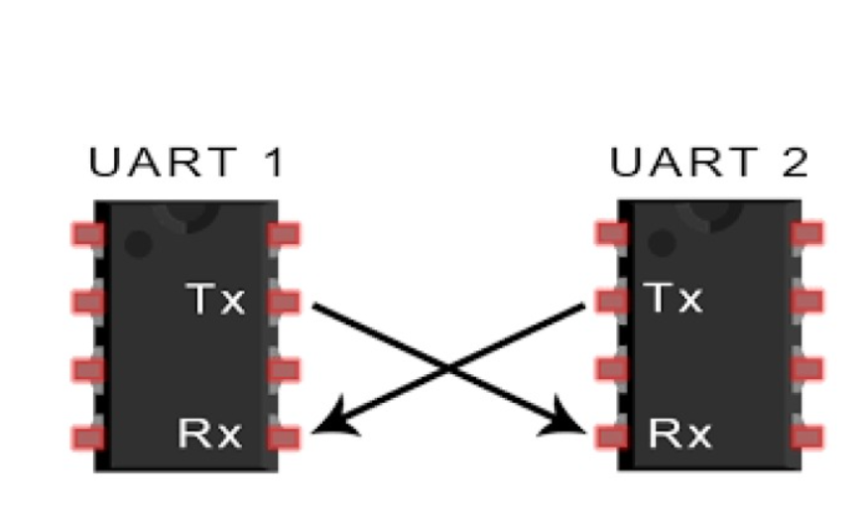
Hardware Connections

Slide 24
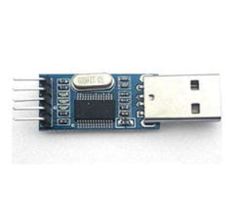

USB to TTL module
USB port UART port

Slide 25
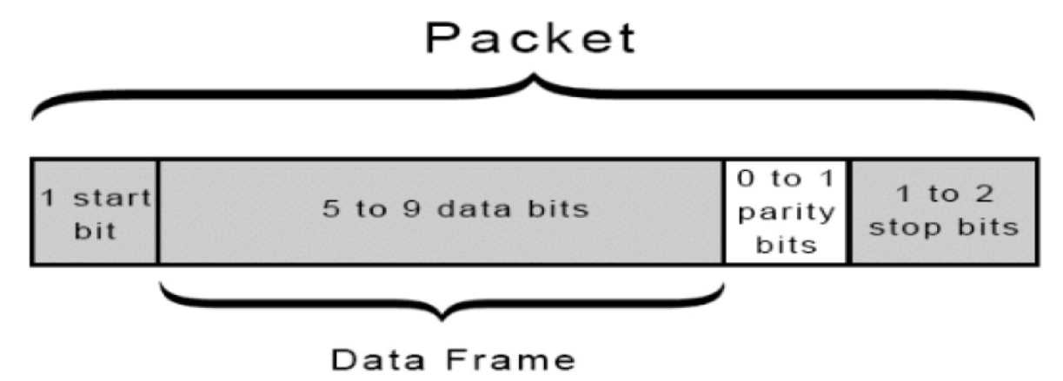
Data Frame format
Throughput = useful data bits / frame bits

Slide 26
Advantages of UART ? 1- simple protocol 2- Hardware complexity is Low 3- Low Cost
Disadvantages of UART ?
1- Peer to peer
2- Not standard protocol

Slide 27
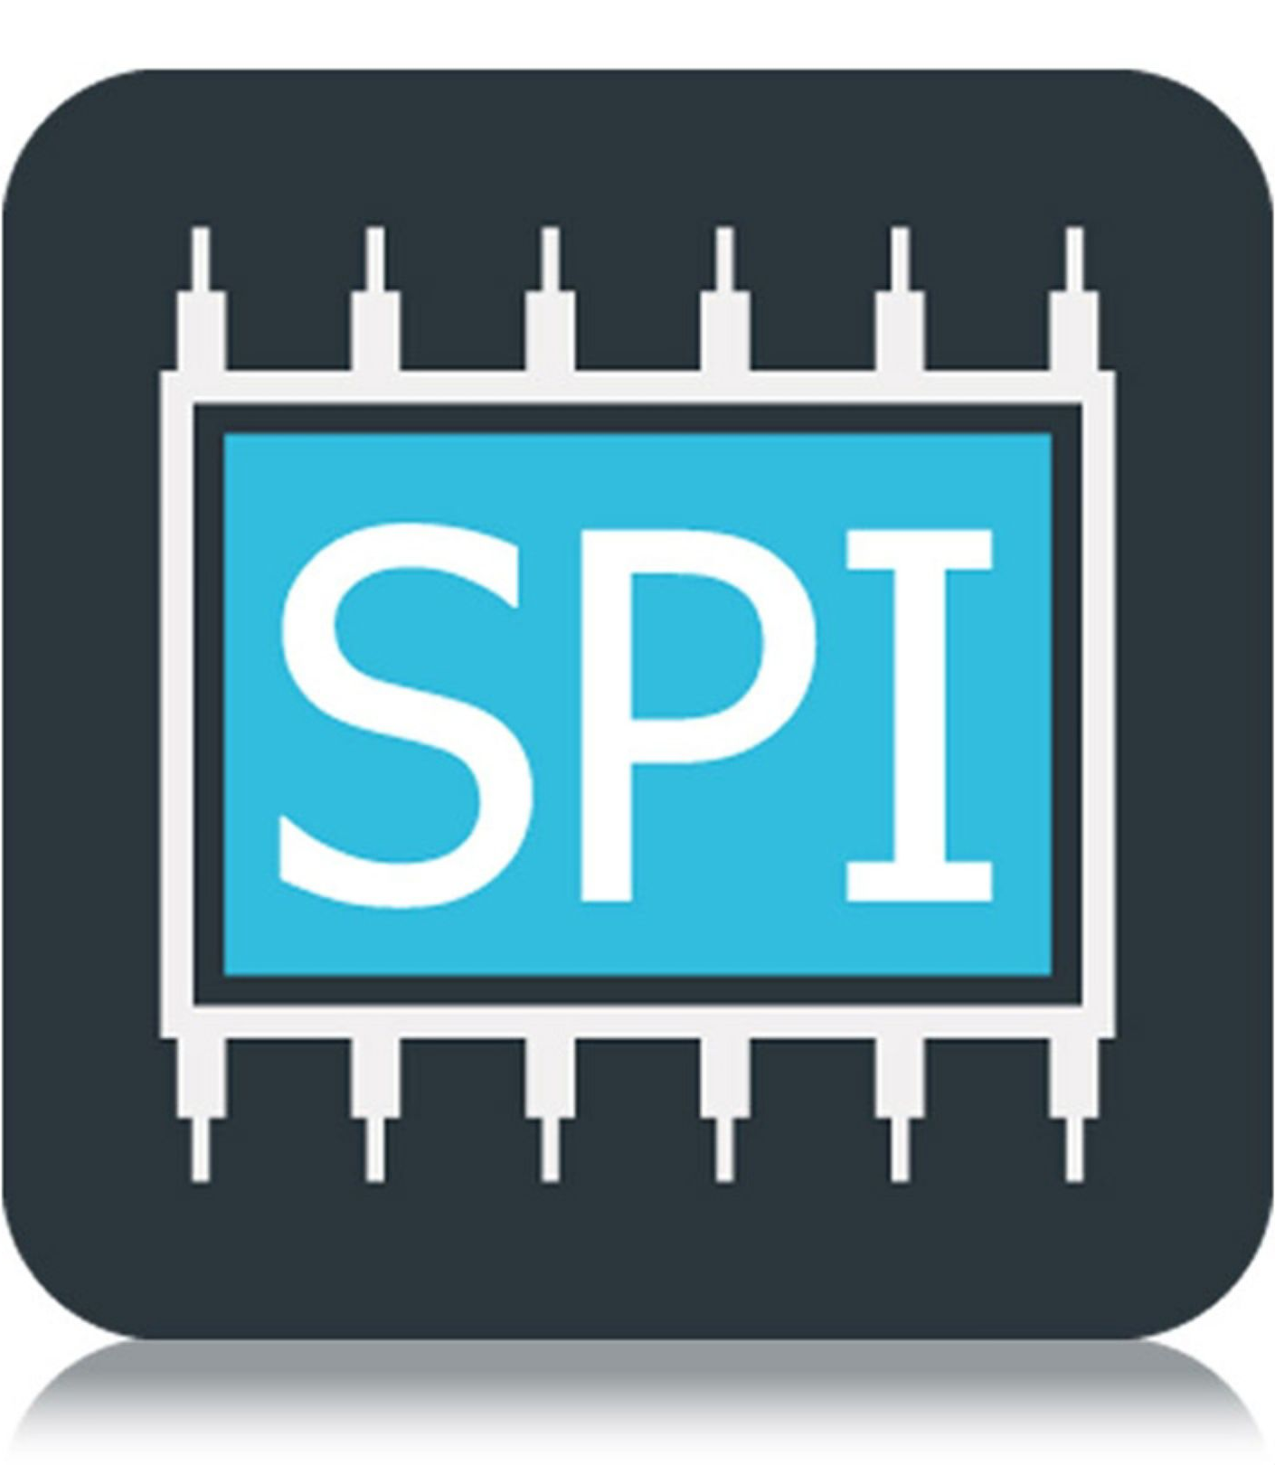
SPI
SPI stands for Serial Peripheral Interface.
Specification
Connection
Operation
Role in Project

Slide 28
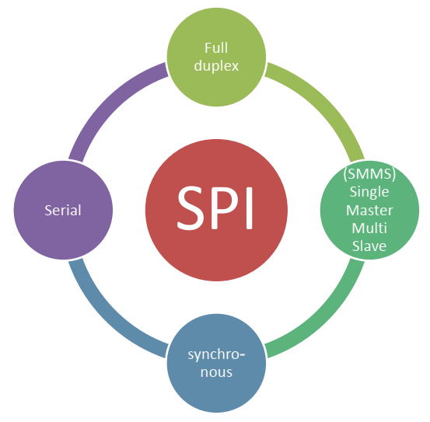
SPI specifications

Slide 29
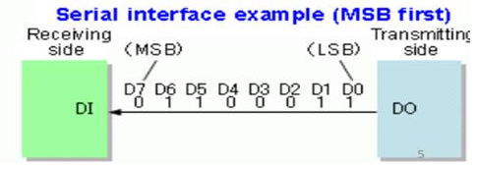
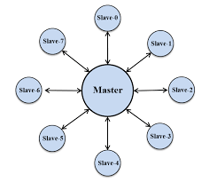
SPI specifications
Transmation technique: Serial.
Node to Node relationship: Master and salve (SMMS).

Slide 30
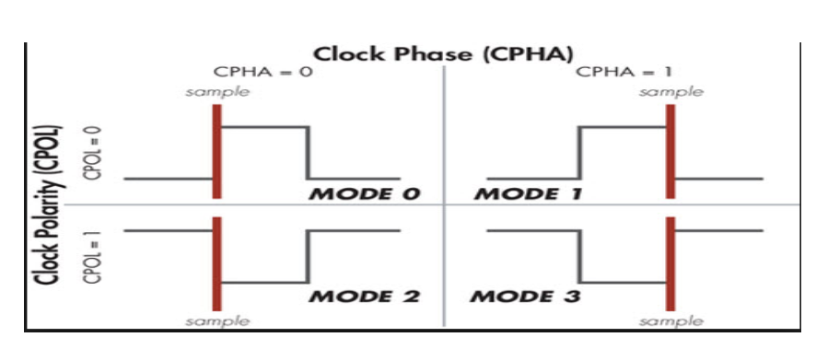
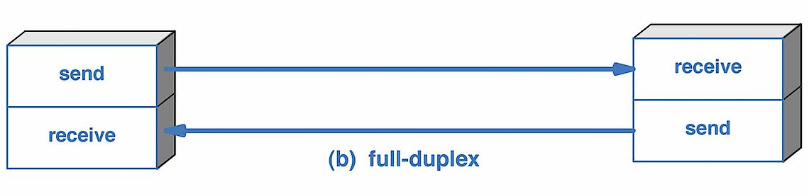
SPI specifications
Synchronization: Synchronous.
Data Direction: Full Duplex.

Slide 31
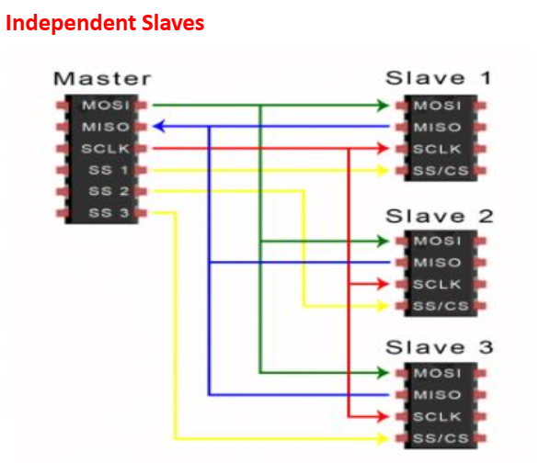
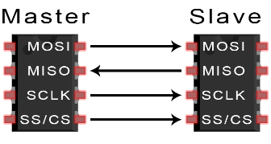
SPI connection

Slide 32
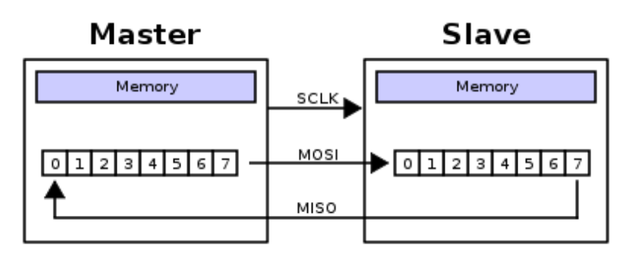
SPI work principal
The SPI operation is a shift register operation.
The master swaps a bit with the slave every clock cycle.

Slide 33
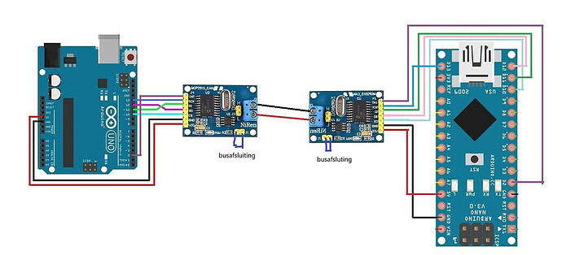
SPI role on the project
The main role for SPI is to create a communication channel between the microcontroller and the external CAN (MCP2515).

Slide 34
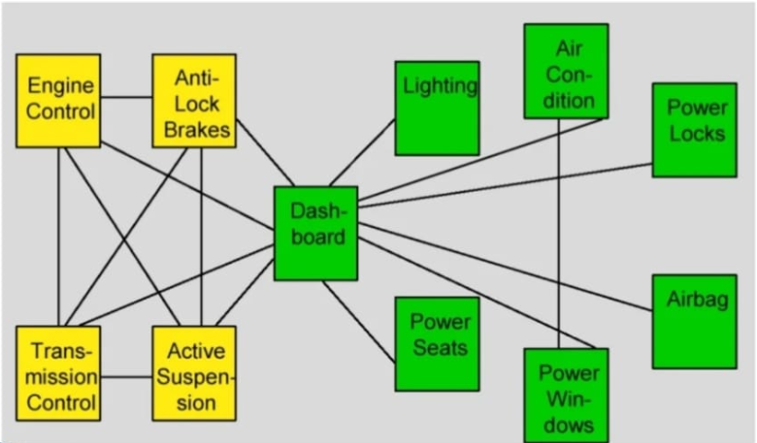
CAN Communication (Controller area network)
Before CAN

Slide 35
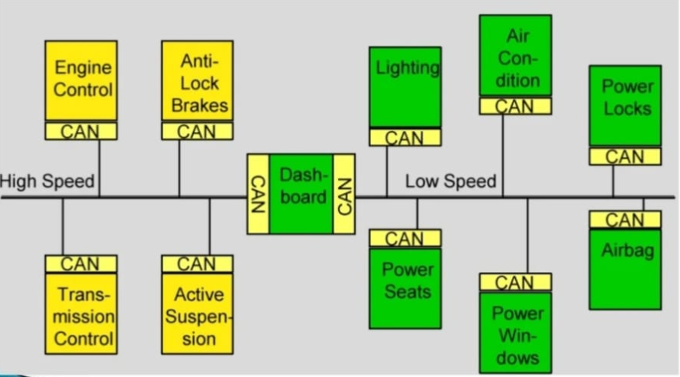
CAN Communication (Controller area network)
After CAN

Slide 36
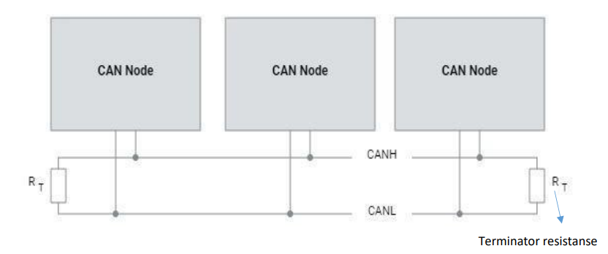
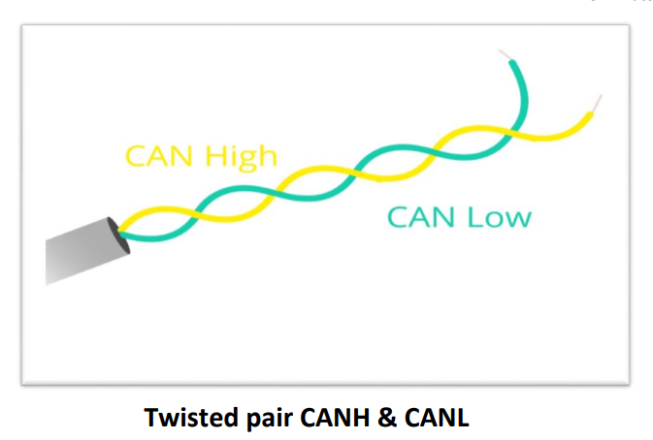
CAN Communication (Controller area network)
Hardware Interface

Slide 37
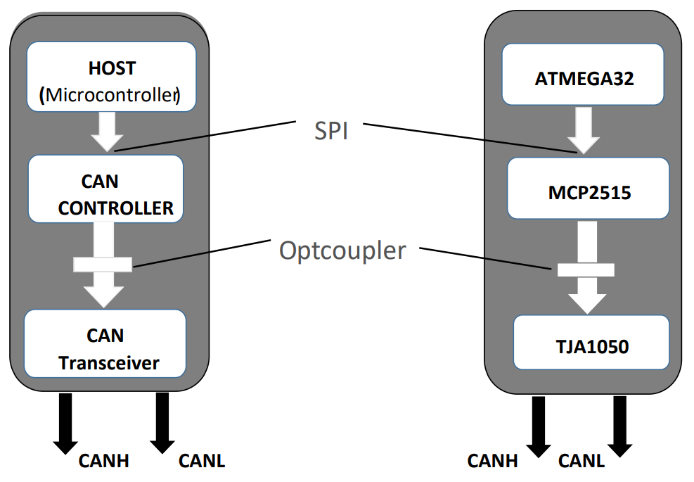
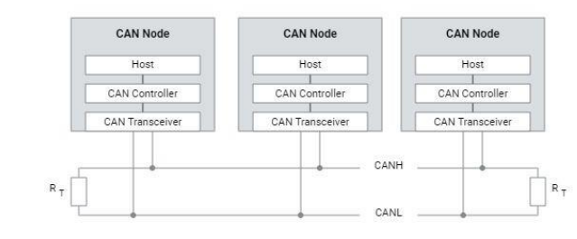
CAN Communication (Controller area network)
CAN Node

Slide 38
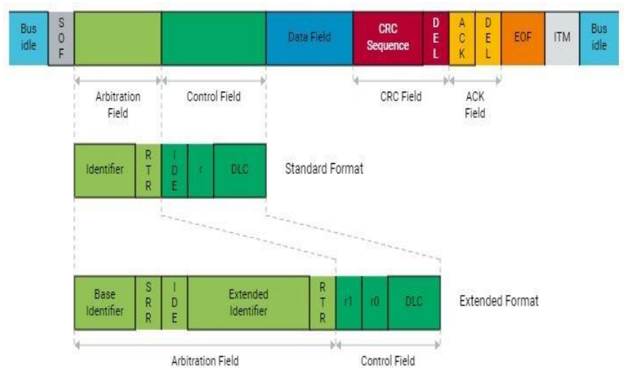
CAN Communication (Controller area network)
CAN Data Frame
Standard Data Frame(IDE = 0 , 2048 ID)
Extended Data Frame(IDE = 1 , 5M ID)
Min Frame size 47 bit
Max Frame size 131 bit

Slide 39
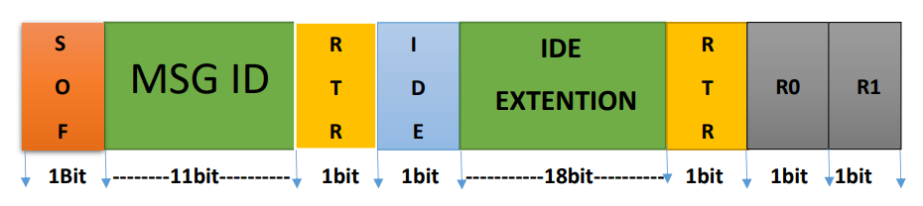
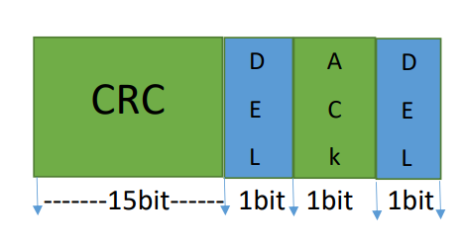
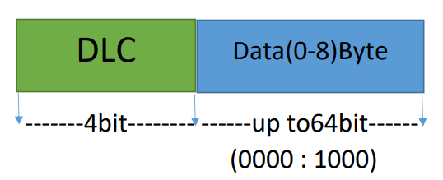
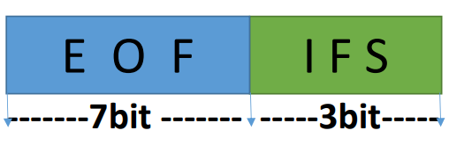
CAN Communication (Controller area network)
Data Frame
1- Massage information
3-Frame Verification
2-Data part
4-End of Frame

Slide 40
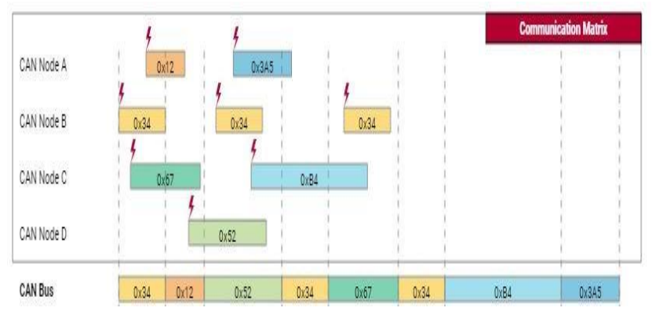
CAN Communication (Controller area network)
Bus Arbitration

Slide 41
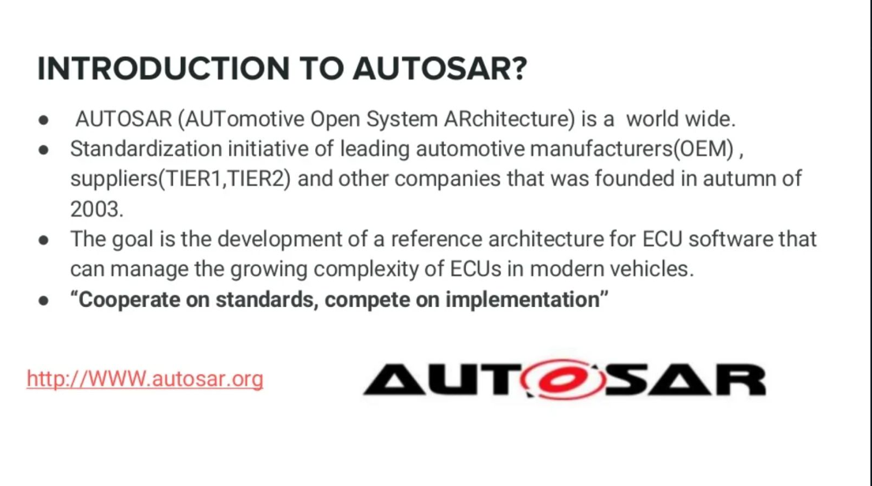

Slide 42
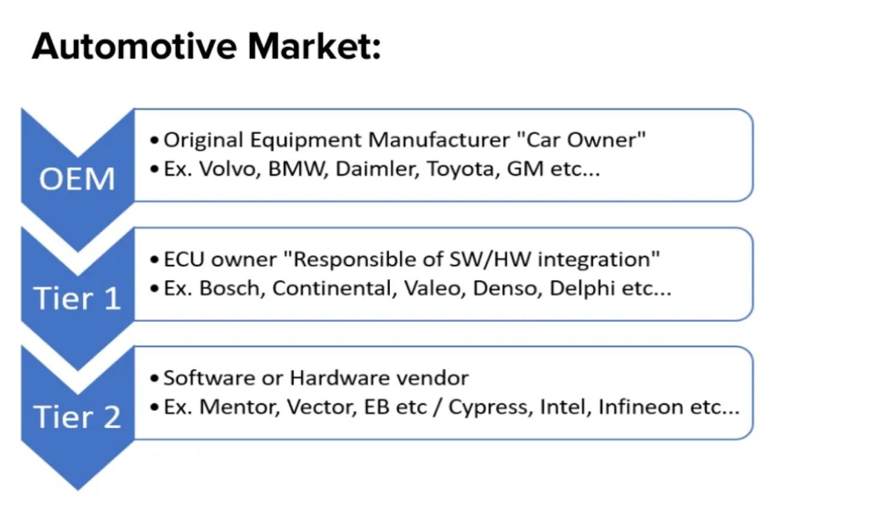

Slide 43
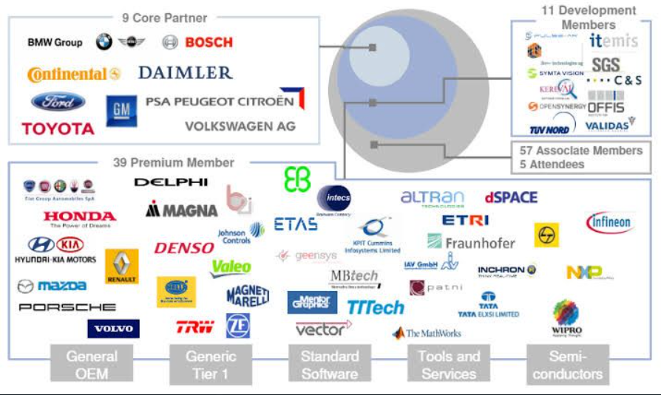

Slide 44
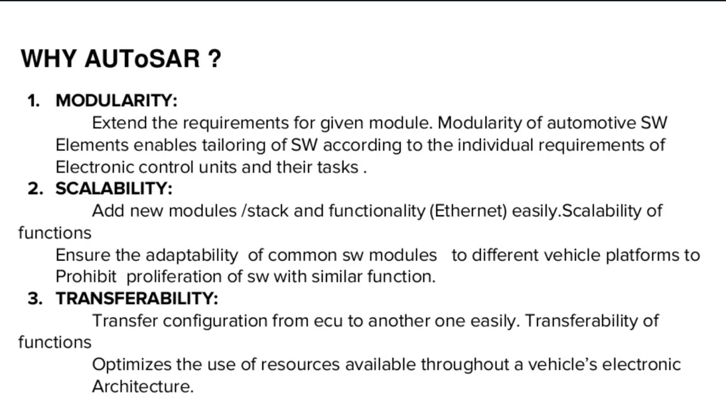

Slide 45
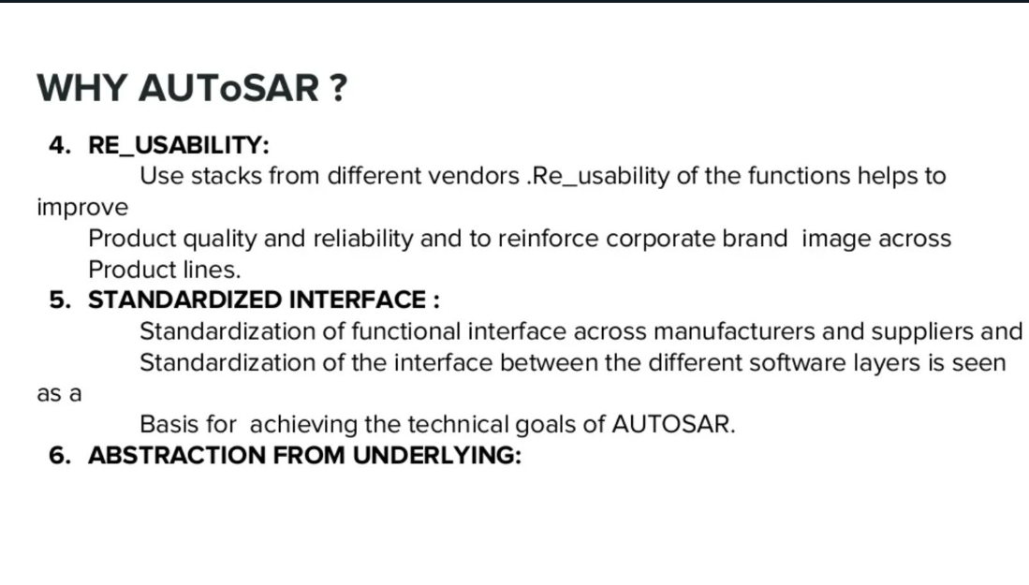

Slide 46
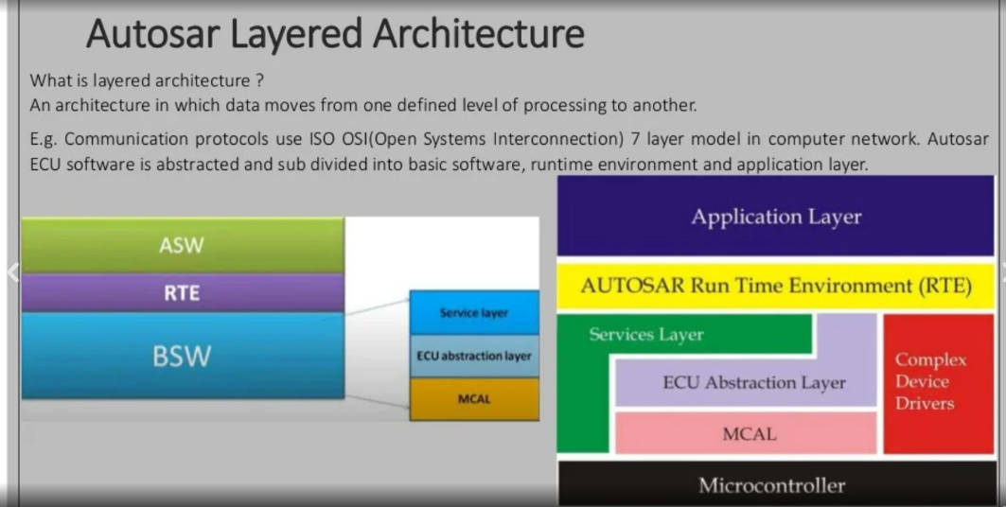


Slide 47


Slide 48


Slide 49


Slide 50


Slide 51
TOOLING
SW Tools
HW Tools

Slide 52

Laptop Camera
The task of this component is to recognize & analysis the face id of the driver & compare it with the IDs in the data base.

Slide 53

ATMEGA32
The task of MCU in this part is to receive the result from the recognition system by USART network (in ECU1).

Slide 54


TTL

Slide 55

MCP2515
The MCP2515 is a second generation stand-alone CAN controller. It is pin and function compatible with the MCP2510 and also includes upgraded features like faster throughput, data byte filtering, and support for time-triggered protocols.

Slide 56

LCD
The main task is to view the result of the output of the system if the car is on or not or the person is trusted or not

Slide 57

HW Tools

Slide 58
SW Tools
PyCharm
Eclipse
Cross-GCC compiler

Slide 59

Future Work
IOT
Internet of things

Slide 60


